Slide 1
Building Apps for the Office Store
Jim Epes, Office Store Product Marketing Manager
Scot Hillier, Office 365 MVP

Slide 2
Overview of the Office App Store
Module 1

Slide 3

Jim Epes
Office Store Product Marketing Mgr.
Drive dev onboarding simplification
8 year Microsoft veteran
Product Planning for O365 and Lync
Business Planning for Office Store and Syndication Channel
Product Planning for MS Hardware

Slide 4

Scot Hillier
Office 365 MVP
Developer, speaker, author, trainer
20 books on Microsoft technologies
SharePoint Conference speaker
Trainer for critical Path Training
Community Lead for ITUnity

Slide 5

Agenda
Why build for Office?
Leveraging the Office Platform
Reaching Users via the Store
What You Can Build for the Store
Store Futures
Demo: The Store User Experience

Slide 6
Why Build for Office: The App Model Overview

Slide 7
The Opportunity
Mobile Devices
1.3B in 2014
1.9B in 2018
1B+
450+ PB
2-3 hours/day in Office Apps

Slide 8
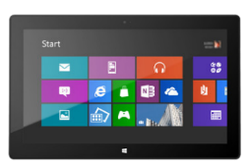



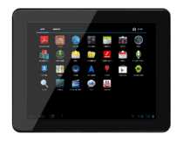

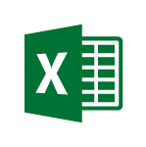
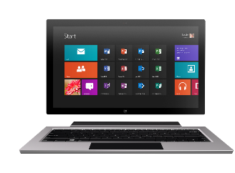
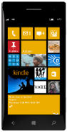

Technology journey
PC
1990s
PC + Servers
2000s
Devices + Cloud
2010s
VBA
VBA
Com add-ins
VSTO
FTC
Open standards
Mobile SDK’s

Slide 9
Office 365 is a rich platform ripe for extending and integrating with.

Slide 10
Benefits of the new app model
Safe and robust
App code runs outside of Office … with clear security boundaries
Clearly defined API build on modern standards
Device friendly
Apps run in the full Office client apps
Works on Tablets and Phones
Clients for iPad, Android, Office Web apps have joined the story
Modern development
Build Apps for Office using modern development tools and technologies
Robust APIs in Office and Office 365
Flexible tools such as HTML5, JavaScript, Xamarin, Azure and Visual Studio

Slide 11



What’s New
EXTEND OFFICE EVERYWHERE
CONNECT TO OFFICE 365 SERVICES
BUILD USING AN OPEN PLATFORM
My Apps
Users and groups

Slide 12
What’s New
EXTEND OFFICE EVERYWHERE
CONNECT TO OFFICE 365 SERVICES
BUILD USING AN OPEN PLATFORM
Users and groups
Files
My Apps
Users and groups
Mail
Calendar
Contacts

Slide 13


What’s New
EXTEND OFFICE EVERYWHERE
CONNECT TO OFFICE 365 SERVICES
BUILD USING AN OPEN PLATFORM
Users and groups
Files
My Apps
z
Mail
Calendar
Contacts

Slide 14










Vision
EXTEND OFFICE EVERYWHERE
CONNECT TO OFFICE 365 SERVICES
BUILD USING AN OPEN PLATFORM
Delve
z
Users and groups
Files
Mail
Calendar
My Apps
Video Portal
Contacts
Office Graph
Presentations
Documents
Spreadsheets
Lync
OneNote
Yammer

Slide 15
Leveraging the Office Platform

Slide 16

Multiply your impact
Microsoft
You
Customers
Platform
Build rich solutions
Use rich solutions everywhere

Slide 17

How?
Services (SI)
ISVs
Building solutions for Office 365
Custom apps
LOB opportunities
LOB to Office integration scenarios
Mobile applications
Migrating to the cloud
Existing solutions and data
Apps for Office and SharePoint
Outlook, Word, Excel, PowerPoint, Access, SharePoint
Apps using Office 365 services
SaaS apps integrating to Office 365
Mobile apps integrating to Office 365
Files, Calendar, Email, People, Office Graph, Search

Slide 18


ISVs: Reaching Users
Developer
Office Store
Users
App Catalog
Choose a channel that best suits your business needs.

Slide 19



How Distribution Works
Office
Seller dashboard
Office Store
Use in-client
Launch in SP
App validation
Free/trial/ buy/subscribe
End user
Partner
Direct
Negotiated deals/
IT projects
App catalog
IT admin

Slide 20
Corporate App Catalog
Secure access to internal apps
Centrally managed repository of private apps
Direct deployment to employees

Slide 21
Reaching Users via the Store

Slide 22



Store facts & figures (Dec. 2014)
Formal Launch:
Store downloads:
Submissions per month:
Validation time:
Jan. ‘13
7M
>350
1.3day
Apps in Office Store:
Active developers
Popular: DocuSign for OLK
Popular: PayPal
1200+
866
Popular: Wikipedia

Slide 23
Store to be localized worldwide by Jan. ‘15 60 Store fronts, 41 supported languages
Stores Opened in 2014
Russia: Russian
China: Chinese
Taiwan: Chinese
Hong Kong SAR: Chinese
Netherlands: Dutch
Belgium: Dutch
Italy: Italian
Brazil: Portuguese
Previous languages supported

Slide 24



Why sell on the Office Store?
Opportunity
Simplicity
Power
Office users.
In-product exposure.
Global reach.
Viral adoption.
Catalog management.
Analytics.
Order fulfillment.
Payments.
Integrated commerce.
Upgrades.
Sales tax tracking and payment
License management tools

Slide 25
Licensing
Free
Trial
Paid
20% revenue share
Per-seat price
Organization-wide price
Subscriptions

Slide 26
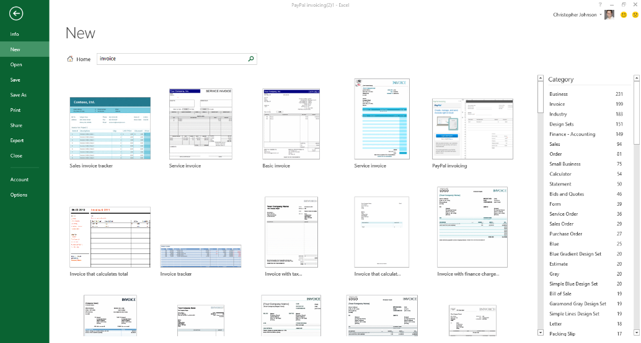
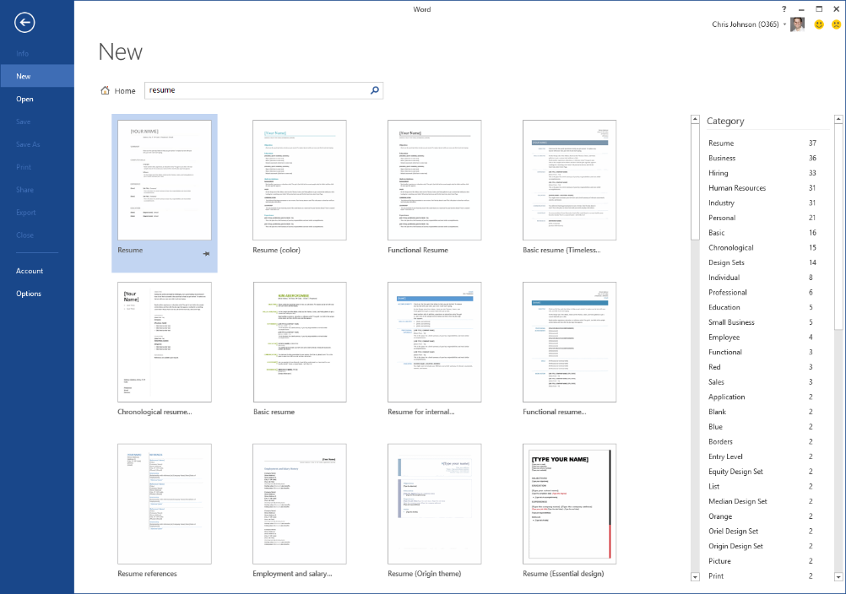
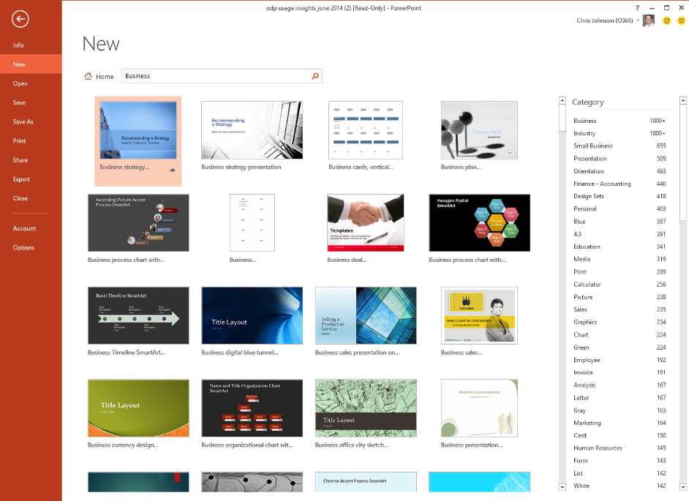
Office 2013 Templates
27M downloads / month
(via ‘File-New’ in Office clients)
App & template can be linked
Makes app discoverable in product

Slide 27


Slide 28
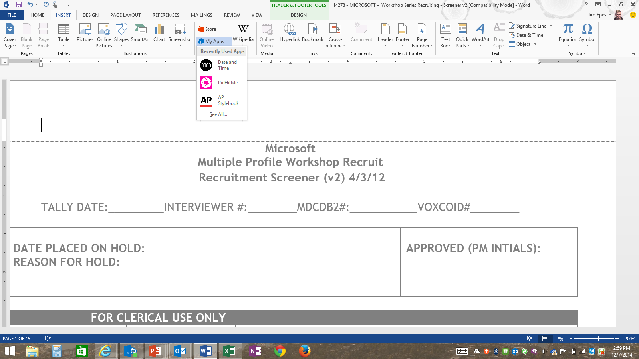
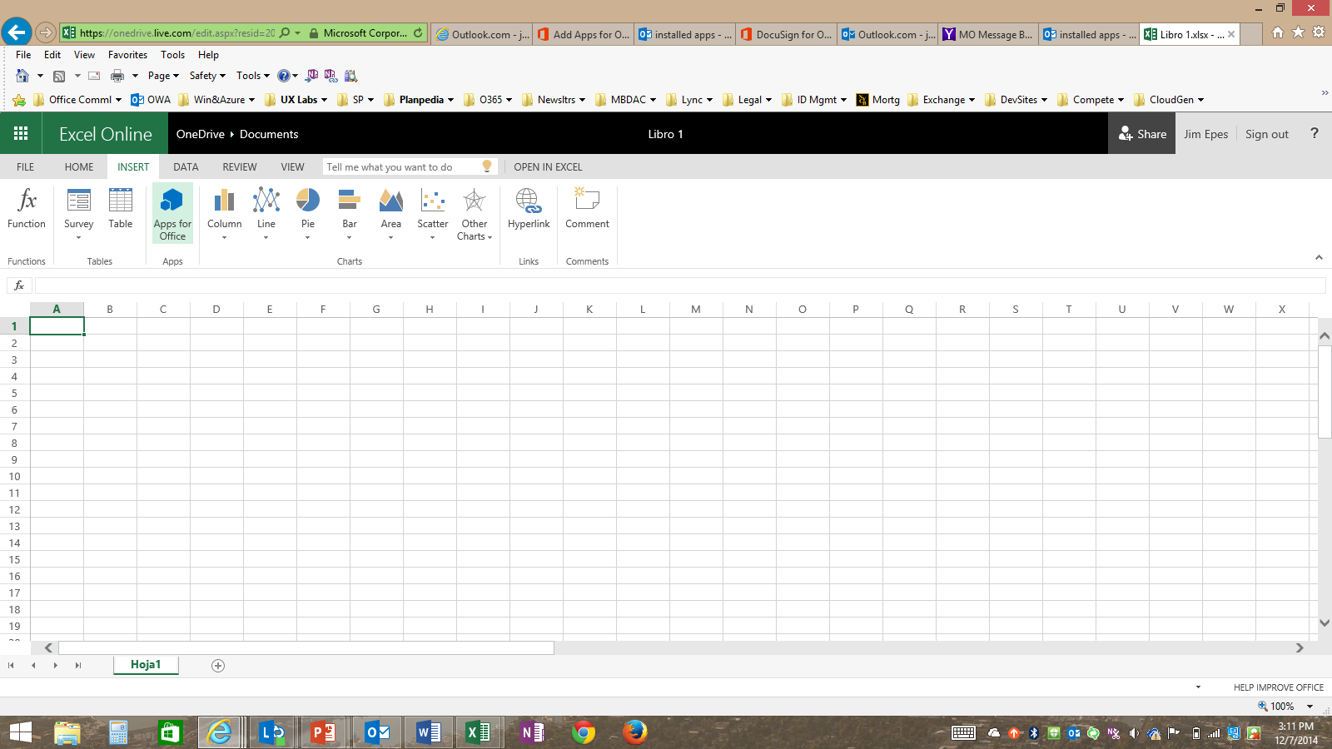
Visibility in the Office ribbon
In the rich client
Word, Excel, PPT, Project, Access
Insert/See Recently Used Apps, get more in Store
In Excel Online (free web version)
New app surface, added Nov. 2014
Adds millions of potential app users
Other Office Online services are candidates

Slide 29
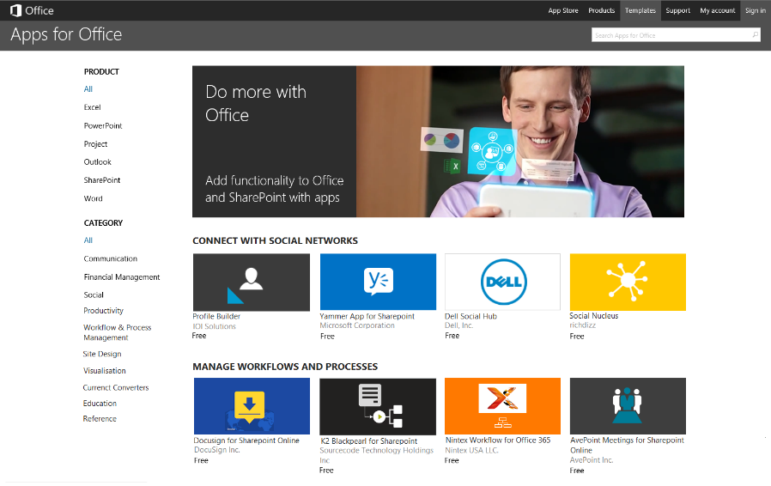
Recent Store improvements
Dynamic, fresh homepages
Better categorization
Review improvements
New design
Fewer clicks to get apps
No sign in for free SharePoint apps

Slide 30
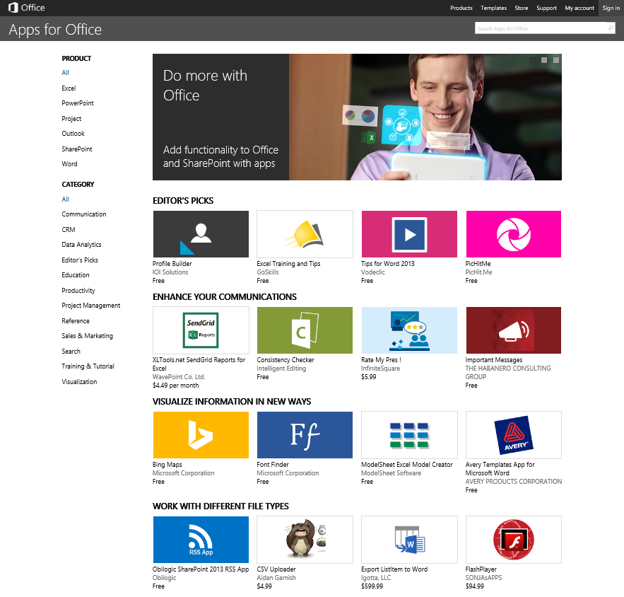
Merchandizing
Features include:
Browse by Category/Product
Editor’s Picks
Weighted, rotating categories
Marketing image carousel (additional marketing surface in future)

Slide 31
Store assortment
Categories
Placement on home page driven by:
Relevance to language, market, Office product
Commitments to ISVs (e.g., “Editor’s Picks”)
Random variable assures category rotation
New Categories with each page refresh
Override rating enables time-boxed promos
Apps w/in a Category:
Home-page placement driven by:
App depth, UX quality, launch experience
App localization status for that market
Customer reviews
Promotional commitments to ISV
Random value to assure apps rotate

Slide 32
Looking forward
Theme-based campaigns
Feature an app collection based on seasonal theme
Example: EDU app for “Back to School”
Build campaigns around a theme
Back by blog posts, social media, & Msoft field (e.g.: Public Sector for EDU apps)
App demos, success stories on SMB site

Slide 33
What You Can Build for the Store

Slide 34
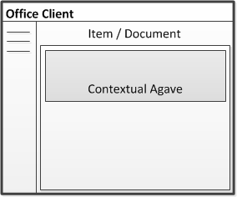
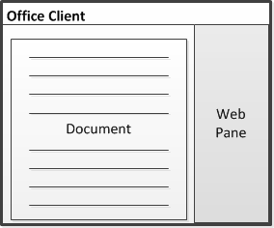
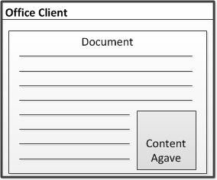
Apps for Office A new way to build extensions for Office
Outlook, Outlook Web Access
In context of mail, calendar items, people card (read & compose)
Contextual pane
Word, Excel, Excel Online, PowerPoint, Project
Task pane area with read/write access to document contents
Task pane
Excel, Excel Online, PowerPoint
App runs within a document’s content
Embedded content

Slide 35
Apps for SharePoint
Full Page
Implement complete app experiences to satisfy business scenarios
Parts
Create app parts that can interact with the SharePoint experience
UI Command Extensions
Add new commands to the ribbon and item menus

Slide 36
Store Futures: New App Types, New App Surfaces

Slide 37
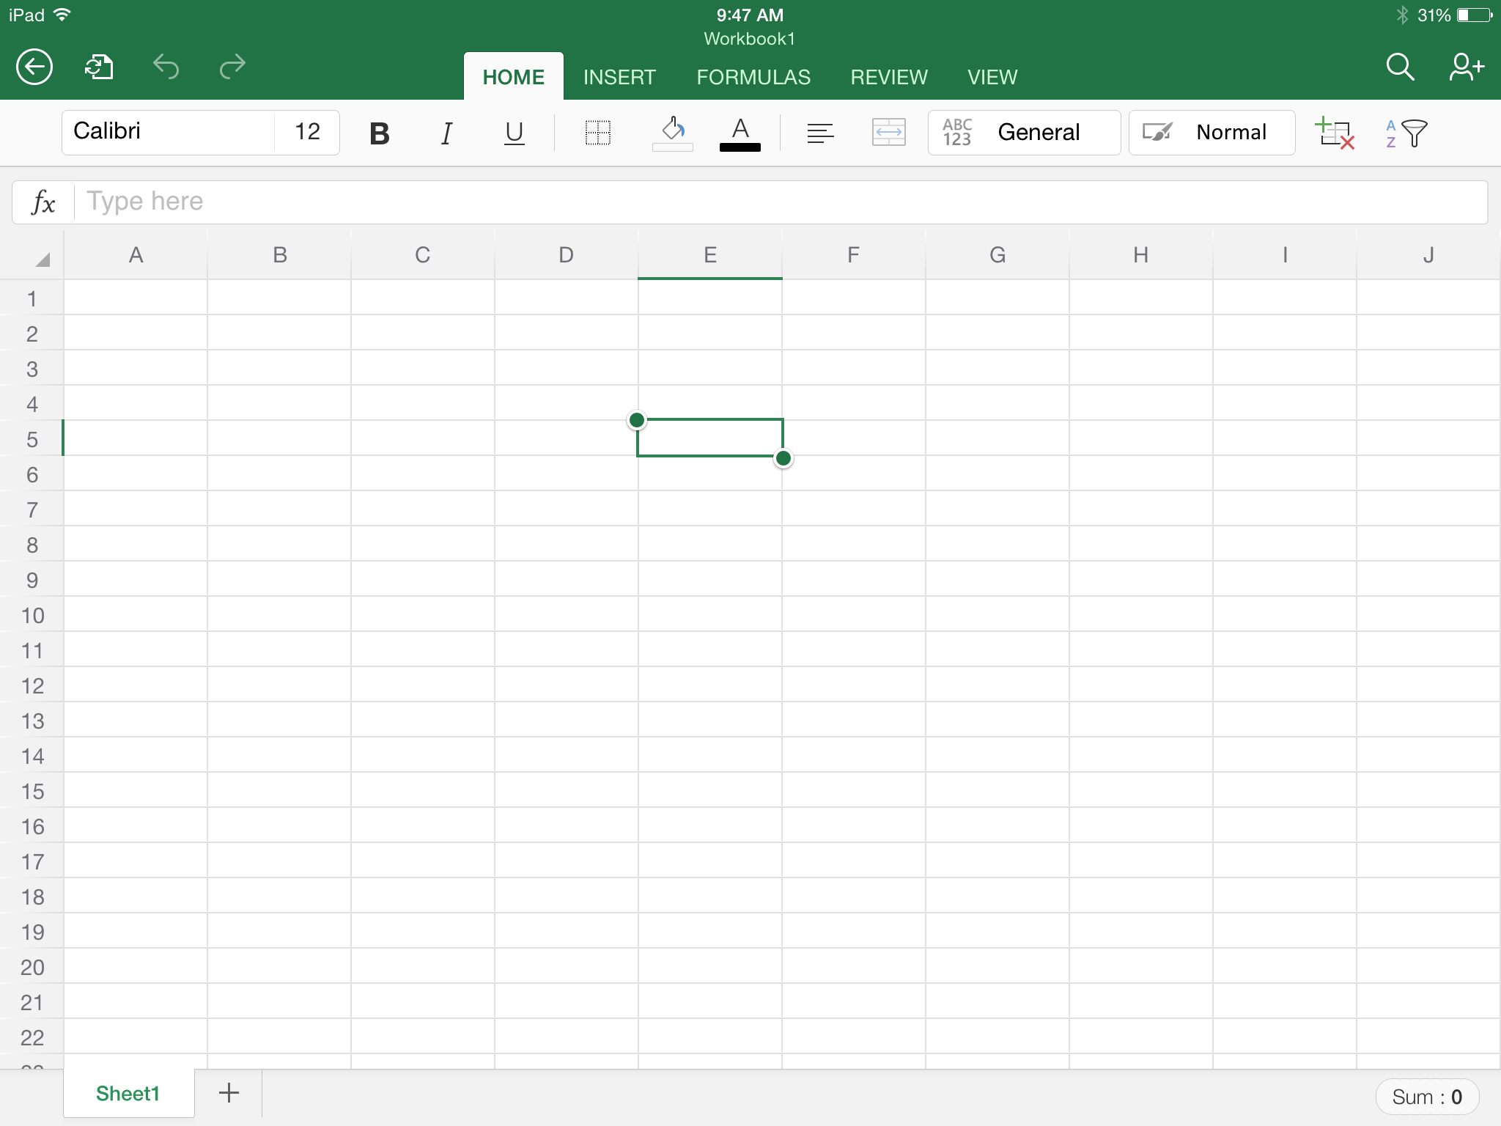






Future App Surface example
Insertion & launch on other platforms
Apps
Recently used
Business Verification
Bing Maps
Wikipedia
Unit Converter
Matter Center
Mavenlink Projects
All apps

Slide 38

Future App Type: Office 365 powered Apps in the Store

Slide 39
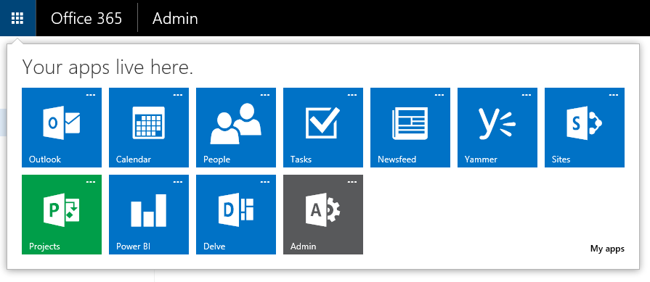
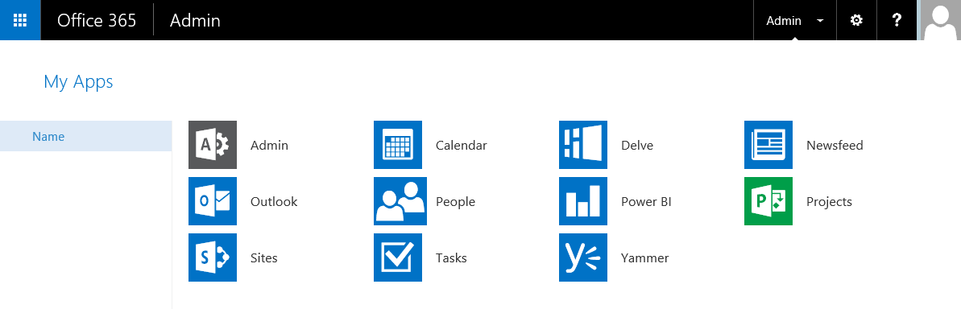
?
your app here
?
and here
Office App Launcher: easily access your apps from the nav bar
My Apps page: where all your apps live
Customizable: pin and unpin apps
Extensible: add enterprise apps (and soon, AAD registered apps from Store)

Slide 40
How to extend the app launcher today
Add apps from the Azure Active Directory Gallery
Create new applications with OpenID Connect
Every Office 365 and Azure subscription has an associated Azure Active Directory
All of the Azure Active Directory features required to register an app are available free of charge
Federated single sign-on
Password single sign-on
For your organization
For other organizations
Get a free subscription by signing up at http://azure.microsoft.com

Slide 41
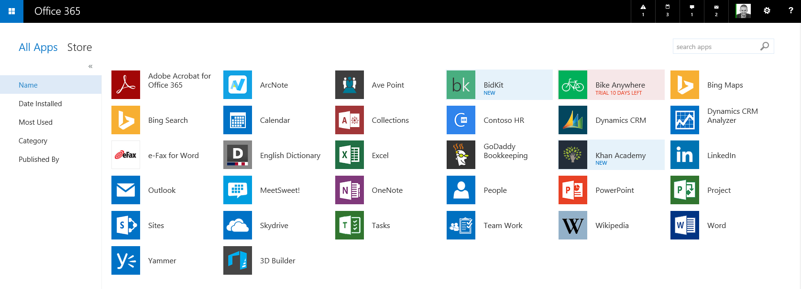
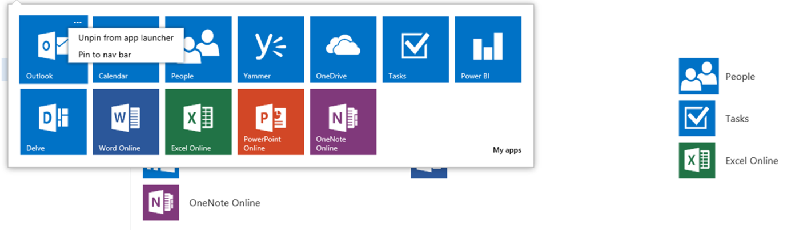
Extending the App Launcher tomorrow

Slide 42
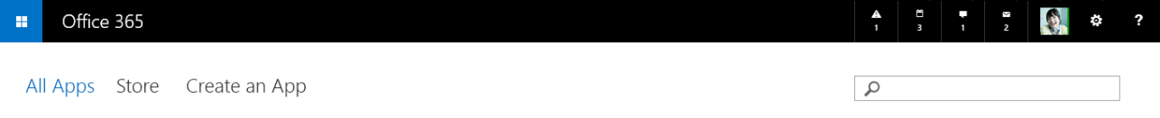
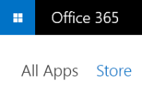
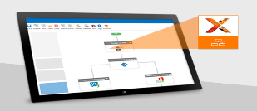



Product
SharePoint
Outlook
Excel
PowerPoint
Project
Word
Suite-level apps
Categories
Content Management
Data Streams
Project Management
Slideshows & Galleries
Time Off
Training & Tutorials
CRM and Reporting
Site Design
Visualization
Forms
Nifty Utilities
Automate business processes quickly
and easily
with Nintex Workflow for Office 365
Try it now
Spotlight Category: Business Insights through data analysis. More >
360 Insight – Insighten ($3.99 | Free trial)
Outside the box – Razor Sharp Inc. ($15.99 | Free trial)
Trello - FogCreek
Connections – ISP ($6.99 / month)
Revolutionized Processes (Ultimate) – RP Inc. ($16.49 / month | Free trial)
Use Social data to make you more productive. More >
Social Trends for Excel – Wishfit (Free)
Prognosis – Live Window.
$84.99 | Free trial
Twitter email feeds – Twitter
(Free)
eVision (Basic) – eSight
($11.49 / month)
Business intelligence in Excel, Project and SharePoint. More >

Slide 43
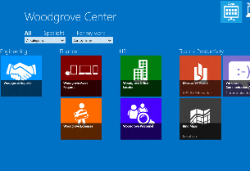

O365 apps will greatly expand the store story
APPS FOR OFFICE & SHAREPOINT
OFFICE 365 POWERED APPS

Slide 44
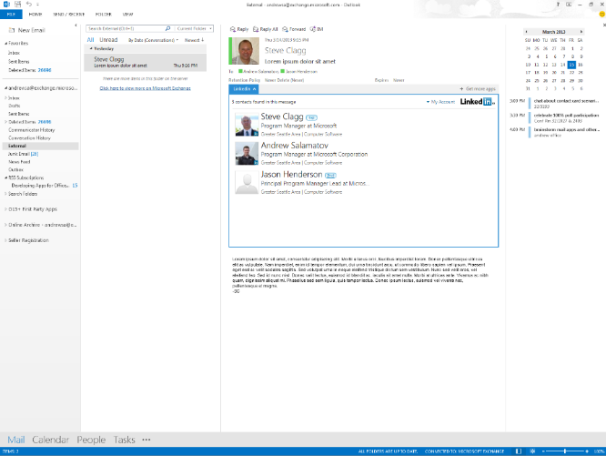
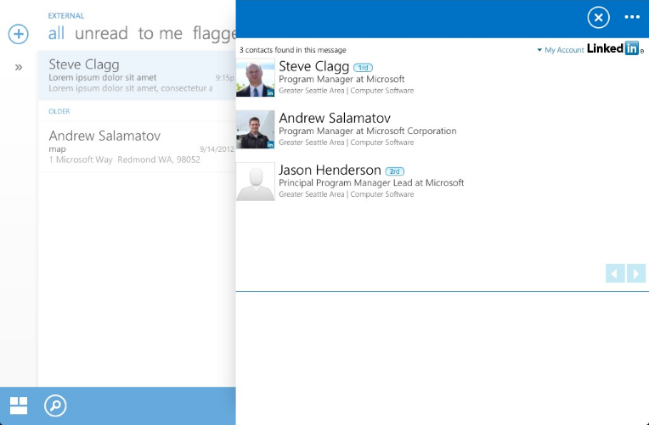
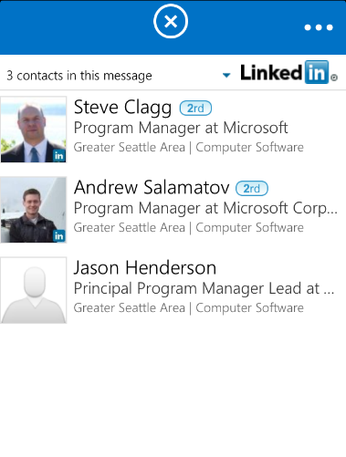
365 Apps are Mobile friendly Write once, run everywhere
Desktop and Web
Tablet
Phone

Slide 45
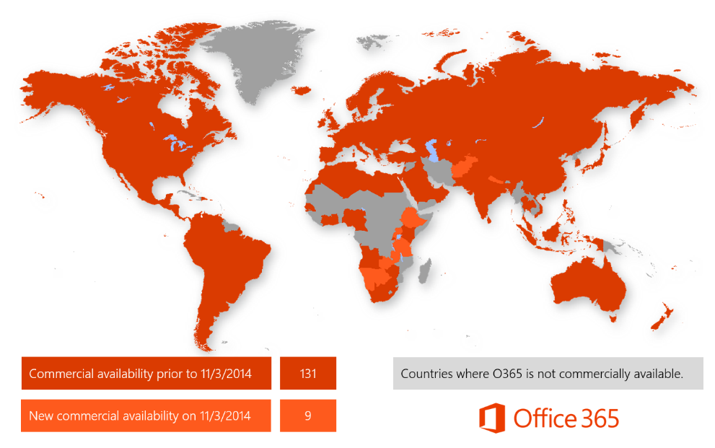
140 Markets
25 Currencies
43 Languages

Slide 46
demo
The store user experience

Slide 47
Next Module: Demo-fest!
Will go deeper on app types, shapes and architecture
Full demos of some leading apps in the Store

Slide 48
Summary
Why build for Office?
Leveraging the Office Platform
Reaching Users via the Store
What You Can Build for the Store
Store Futures
Demo: The Store User Experience

Slide 49



dev.office.com
Sign up
http://dev.office.com/getting-started
Explore
http://apisandbox.msdn.microsoft.com
Get trained http://dev.office.com/training

Slide 50


Feedback
Office 365 Network Share your best practices and join conversations https://www.yammer.com/itpronetwork
Stackoverflow Ask deep technical questions to a world-wide set of developers
http://stackoverflow.com/questions/tagged/ms-office
UserVoice Provide suggestions of what you want in future versions
http://officespdev.uservoice.com/

